Slide 1

INTEGRATING THE CAMERA WITH CHROMECAST SEI CHANG

Slide 2





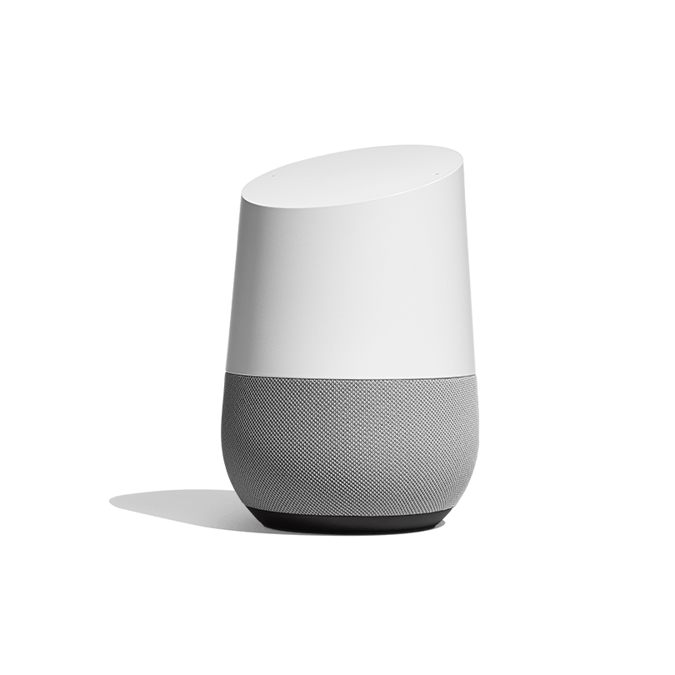
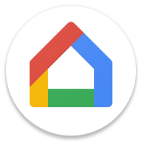
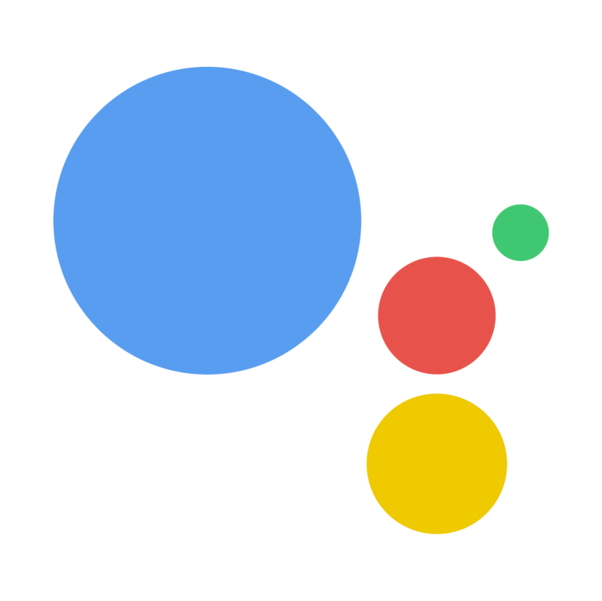

SCHEMATIC
DynamoDB
JSON Database
Camera RTSP
RTSP -> MPEG-DASH
Server
AWS Lambda
Cloud Function
OAuth (Website)
HTTP POST REQUEST
SYNC, QUERY, EXECUTE
Devices
Google Home App
(Home Control)
Actions on Google
Smart Home Action

Slide 3
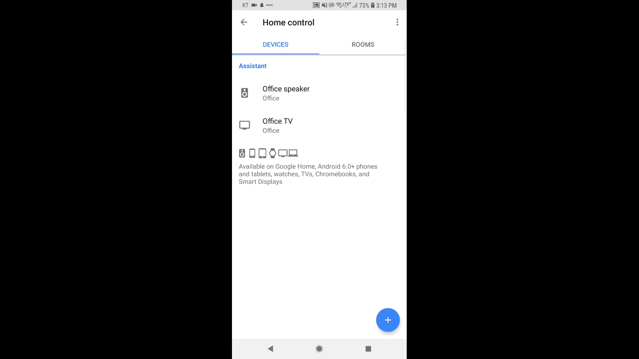
FRONTEND
Google Smart Home
Smart Home App (Actions on Google)
Sends HTTP Request to Cloud Service
SYNC (Info), QUERY (State), EXECUTE (Command)
OAuth Integration
Auth0 Authentication for account linking
Available with Google Sign in
Access Token for User Profile

Slide 4


OAuth 2.0 Flow
cameraID
streamURL
name
DynamoDB
OnOff
Receive User ID
Access Token
Authentication
Profile API GET Request
Access Token + Request
Device Info
User’s Device Info
Home Client
Lambda

Slide 5
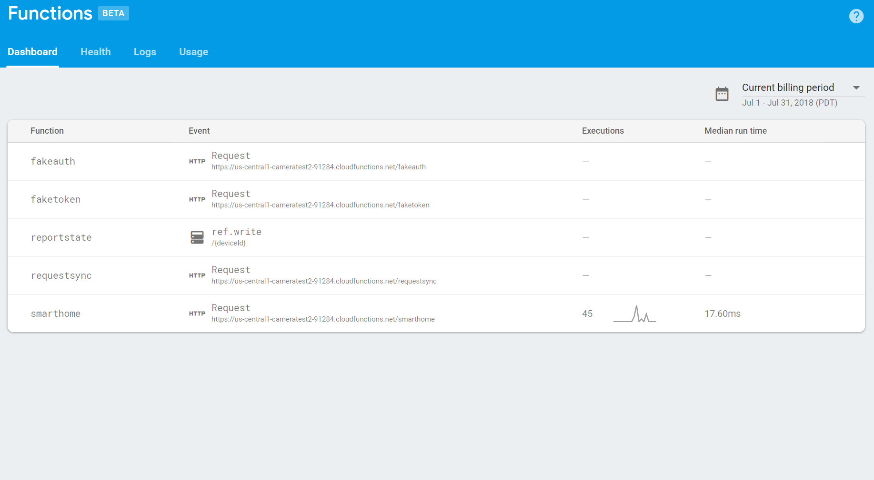
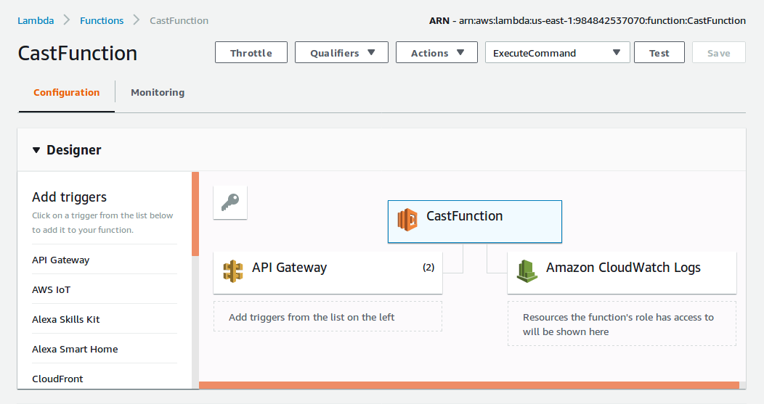
BACKEND
AWS Lambda (Cloud Function)
Handles SYNC, QUERY, EXECUTE
SYNC: Device traits specified (ex. id, CameraStream)
QUERY: Device state (ex. isOn)
EXECUTE: Returns Stream URL
Triggered through API Gateway

Slide 6

BACKEND
AWS DynamoDB
User ID used for Database Key
Matched with OAuth User Profile
Support for Multiple Devices
Unique Device Names
Camera ID
Lambda Updates DB for OnOff
USER
Camera A
Camera B

Slide 7



BACKEND
RTMP-DASH Server
Nginx + Ffmpeg implementation
Able to receive input stream (RTMP, RTSP)
Streams over HTTP through MPEG-DASH
Stream to Chromecast through Local HTTP
Camera Test Success!

Slide 8
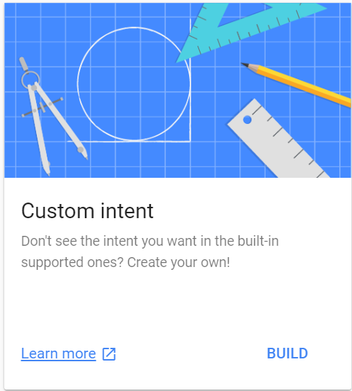
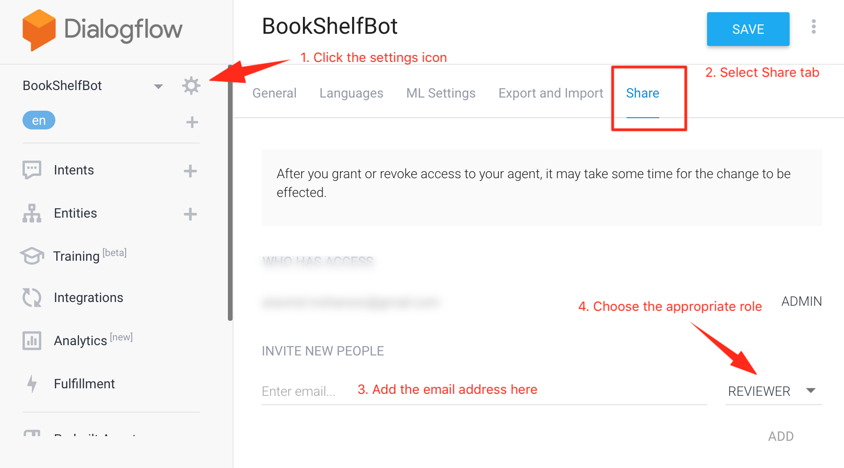
CUSTOM ACTIONS
Google Assistant Actions
Actions SDK or Dialogflow (NLP Service)
Sends custom intents (HTTP Request) to Backend Service (Lambda) for handling
Problem: no available public API for Chromecast Streaming
Solution: Smart Home App + Google Assistant Actions

Slide 9

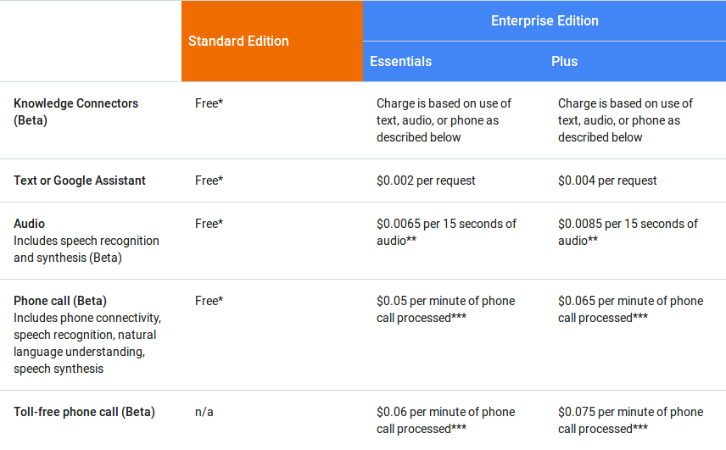
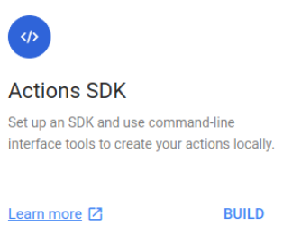
COMPARISON
Google ML NLP Services
Pricing (cost per request)
Google Actions SDK
No NLP Integration
Free for use (Node.js Library)

Slide 10
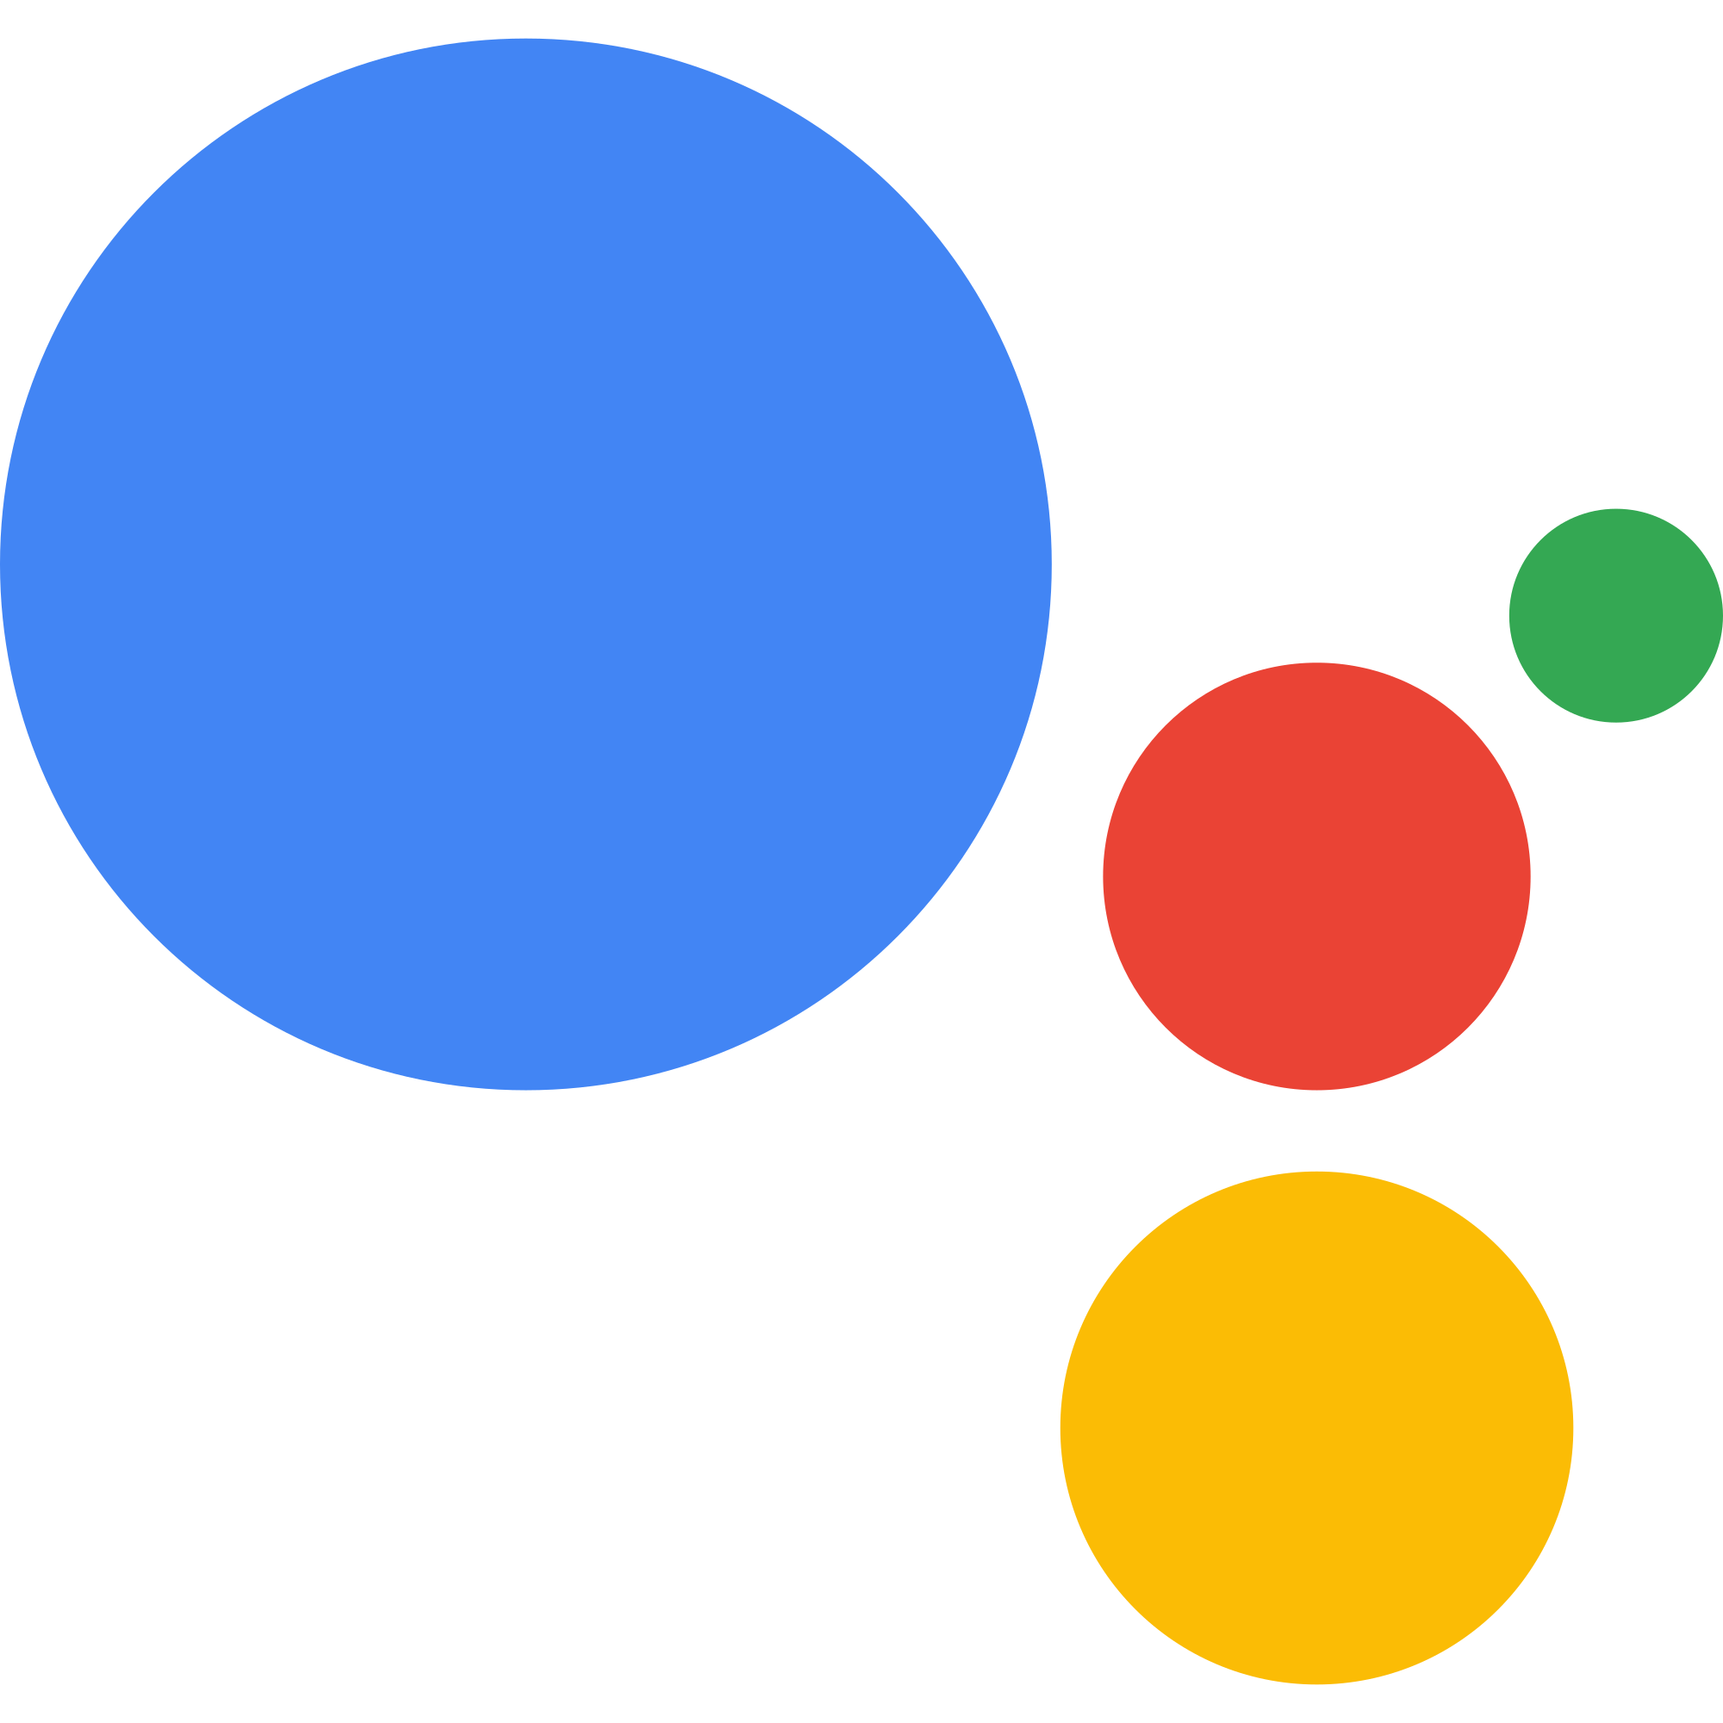
IFTTT INTEGRATION
IFTTT Actions
HTTP Request
Custom API Call
OAuth 2.0 Authentication
Applet Service: Trigger + Action
If this then that
IFTTT Triggers
Voice Assistants (Siri, Alexa, etc.)
Additional Web Service/Apps
Location (home trigger)
Integration with other smart devices (lights)
Indoor Camera Off
I’m home!
Outdoor Camera On

Slide 11
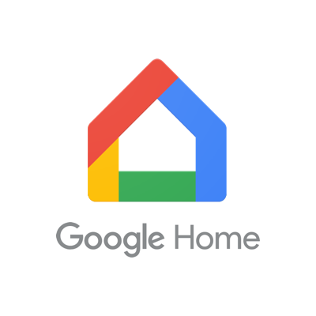


PLANS
OBJECTIVES
Utilize Google Smart Home App
Video Support from Dialogflow (near future)
IFTTT Integration
Full Integration with SMC Cloud

